Slide 1
TASK DIFFERENTIATION IN A BEE HIVE
Giovanna Ferraro – anno accademico 2023/2024

Slide 2
TABLE OF CONTENTS
01
02
03
04
OBJECTIVE OF THE PROJECT
AGENTS AND ENVIRONMENT
SIMULATIONS
FURTHER WORK

Slide 3
01 OBJECTIVE OF THE PROJECT
1
2
3
4
System
Context-Awareness
Attractors
Swarm intelligence?
Via indirect interactions between agents and environment
Whether the system is at the edge of chaos or not
Define agents and interactions between bees
Simple agents performing intelligent things

Slide 4
02 AGENTS AND ENVIRONMENT
AGENTS
INTERACTIONS
ENVIRONMENT
Indirect, by looking for the information in the environment
Pure reactive system with offline planning
Regular lattice matrix- like environment
Holds resources
Where the agents are located
Used to «leave» and get information
Queen bee
Larvaes
Nurse bees
Guard bees
Forager bees

Slide 5
02 AGENTS AND ENVIRONMENT
Guard bees
With a P(x) they die, simulating fighting with intruders
Queen bee
Lays egg
Forager bees
With a P(x) they die, simulating death while foraging
Forage for food simulated by a random number from (1,8)
Nurse bee
Feed the larvaes

Slide 6
03 SIMULATIONS
All nurses | All foragers/guards | Half nurses half foragers | Half nurses half guards
Expect the bees to die Very few scenario where the hive survives | The hive can’t survive since there are no nurses | Ideal situation, the hive survives every simulation | Ideal situation, the hive survives every simulation
Bees died the majority of the simulations Few scenarios they survived | The hive never survived any simulation | The hive survived every simulation with great results | The hive survived every simulation with great results

Slide 7
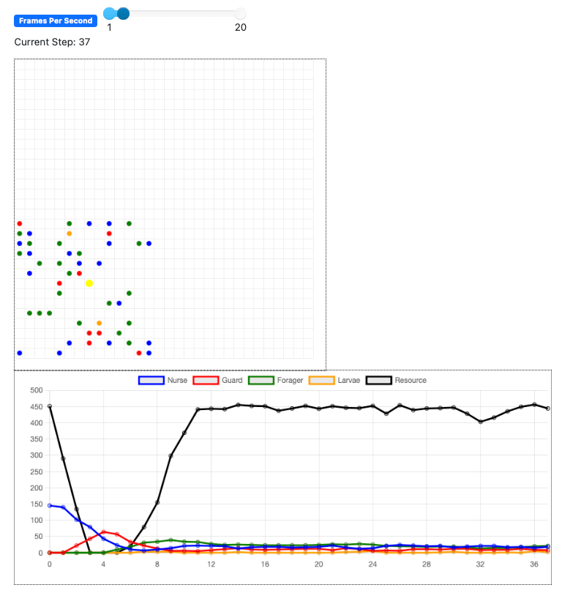
ALL NURSE BEES

Slide 8
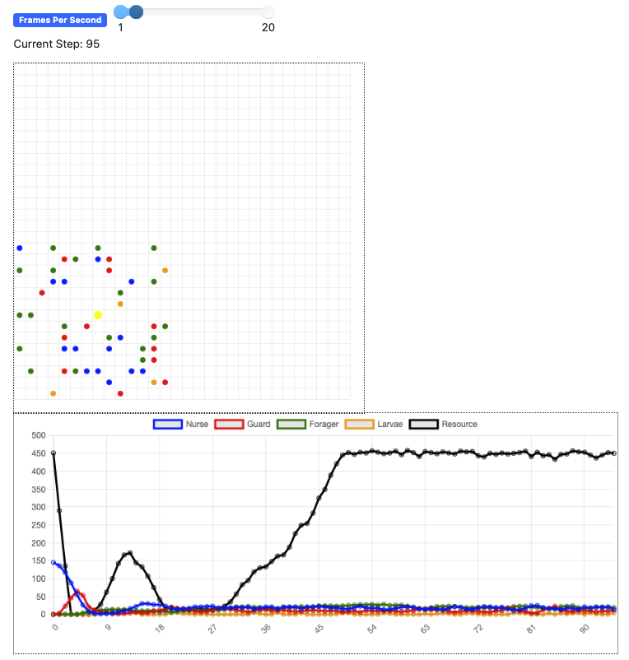
ALL NURSE BEES PT.2

Slide 9
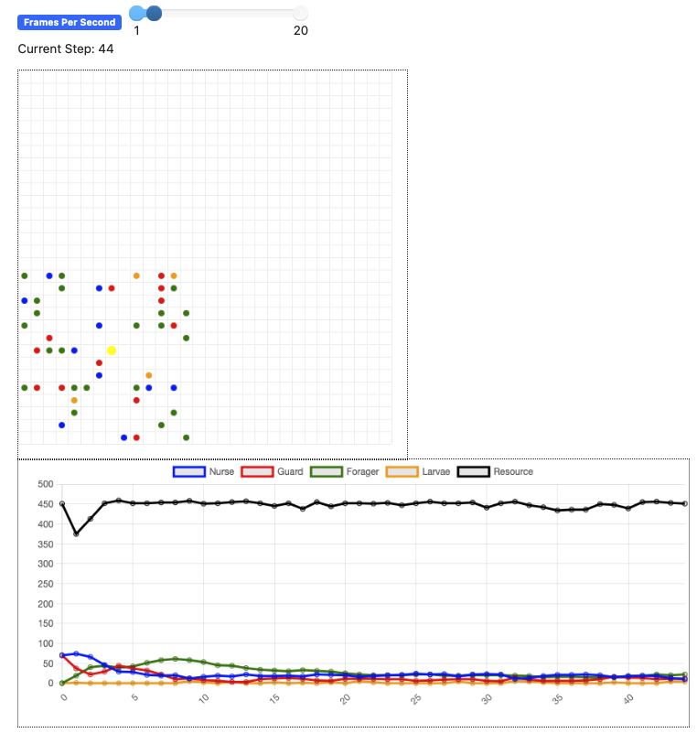
HALF NURSES HALF GUARDS

Slide 10
03 SIMULATIONS
Added movement of nurse bees!
Before:
Data looked a bit synthetic
No unexpected behaviors
Nurse magically found larvaes to feed
Now:
Data look more realistic
More «chaotic» behaviors
Nurse have to look for larvaes to feed
Moving towards a swarm intelligence system

Slide 11
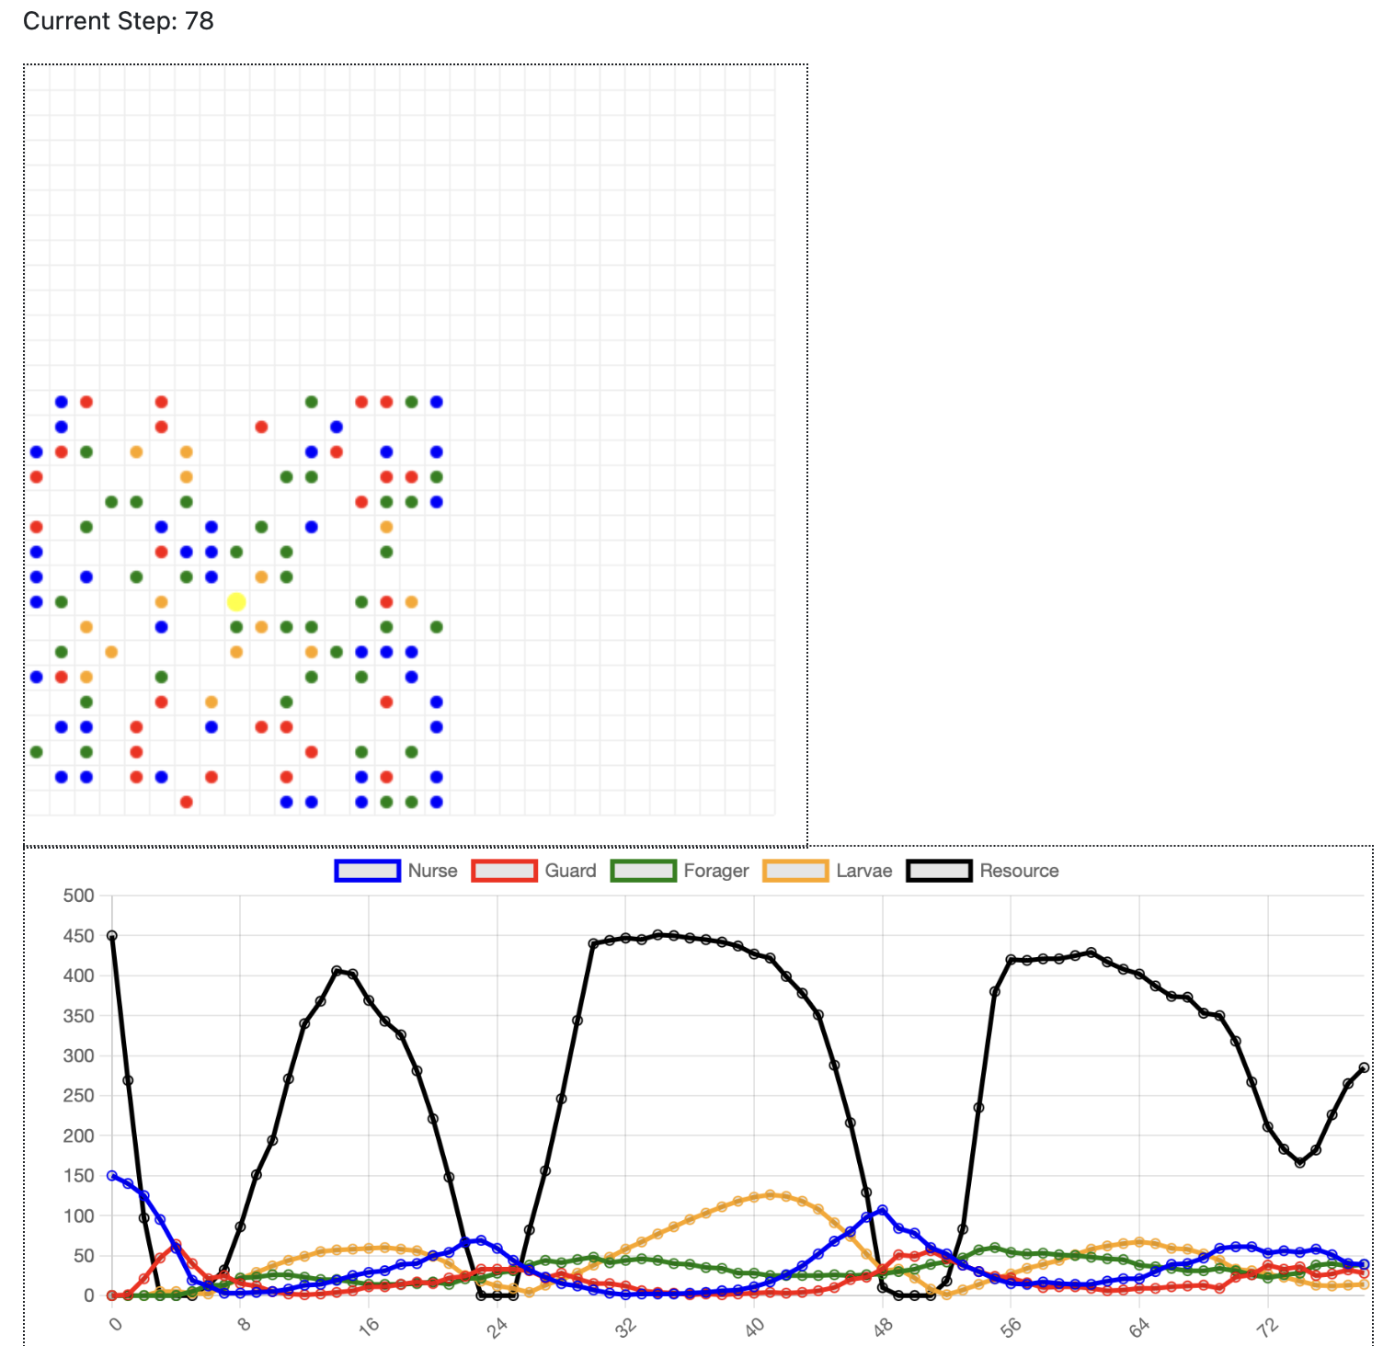
ALL NURSE BEES

Slide 12
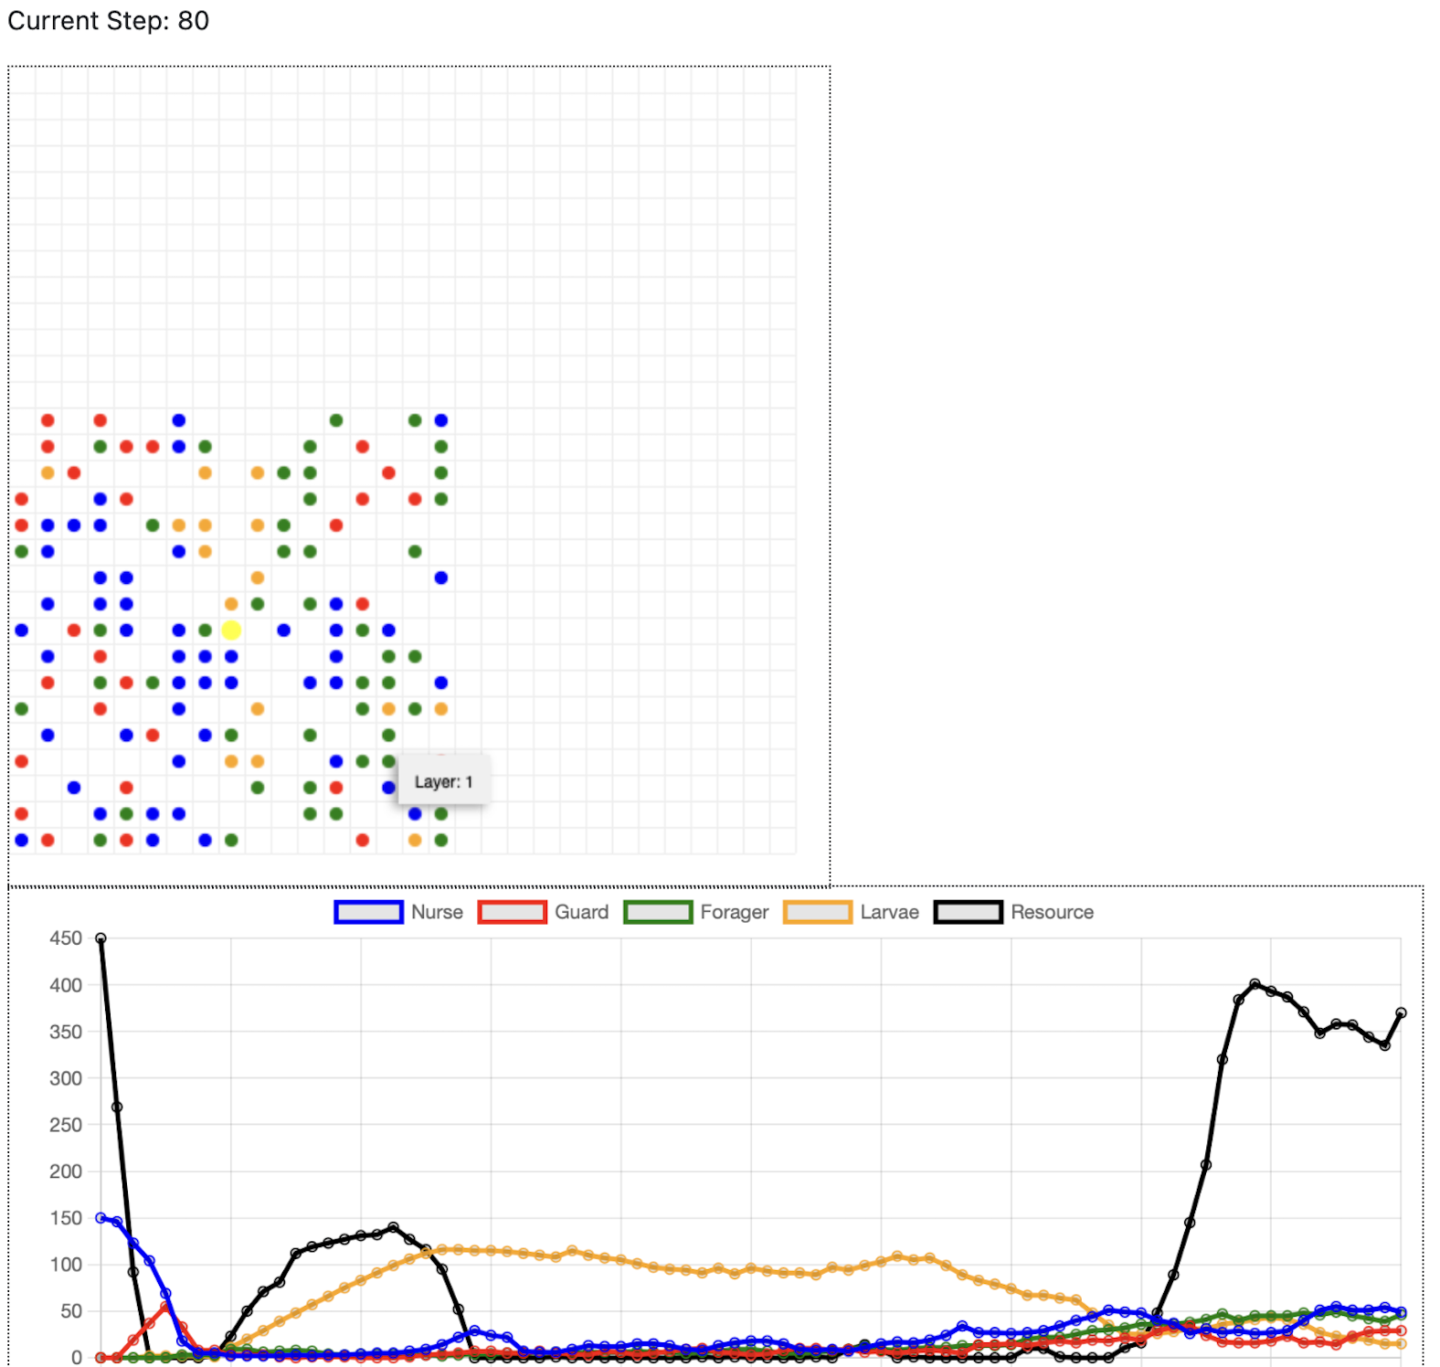
ALL NURSE BEES PT2

Slide 13
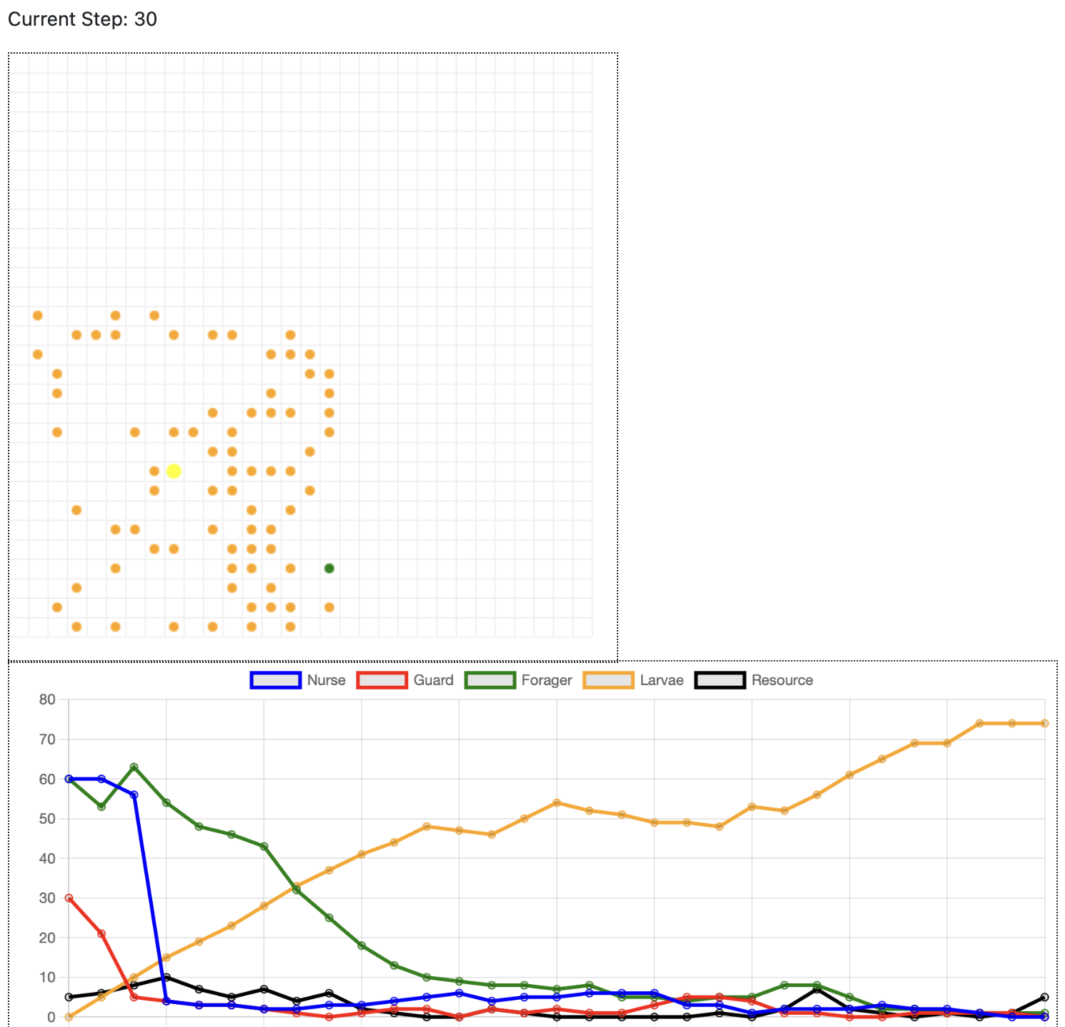
WHAT IF THERE ARE NO INITIAL RESOURCES?

Slide 14
04 FURTHER WORKS
Add seasonality
Add locality to the resources
01
02
Foragers also can move around inside and outside the hive
→ More context awareness and a step forward swarm intelligent system
Based on the weather, bees forage different level of food and eat different levels of food
→ To better simulate the hive and add more context awareness

Slide 15
THANK YOU FOR THE ATTENTION

